Slide 1



Agentic AI & Prompt Engineering
A Beginner-to-Intermediate Guide to Steer AI Systems Exceptionally Well

Slide 2


What is Agentic AI?
From "Chatting" to "Acting"
Traditional AI only answers questions when asked. Agentic AI refers to systems that can make decisions, use tools, and work independently to reach a goal.
A Simple Way to Think About It
Traditional AI (The Assistant): You ask: "Summarize this PDF." It reads and outputs text.
Autonomous: Learns to act without constant human help.
Goal-Oriented: You give it a target; it figures out the steps.
Agentic AI (The Project Manager): You say: "Find bugs in our software, test fixes, and email the team." It coordinates tools and finishes the task on its own.
Tool-Using: Can search the web, calculate numbers, or run code.

Slide 3

Key Benefits
Why Master This Now?
90% of companies are starting to rely on Agentic AI patterns to automate workflows. Learning how to direct these systems is the ultimate future-proof skill.
90%
Scale Workloads: Let AI handle complex multi-step processes.
Save Hours: Automate data collection, parsing, and execution.
FUTURE ENTERPRISE ADOPTION
Career Growth: Transition from typing basic chats to architecting automated AI systems.

Slide 4







Course Curriculum
Our learning path is split into three simple, progressive phases:
1. Foundations
2. Core Frameworks
3. Agentic Systems
AI essentials, core architectures, and standard prompt templates.
Building smart workflows with LangChain, LangGraph, and RAG systems.
Developing multi-agent crews with CrewAI, Autogen, and Cloud deployment.

Slide 5


Introduction to Prompt Engineering
The Art of Communicating Clearly with LLMs

Slide 6


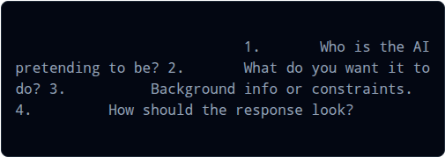
What is Prompt Engineering?
Basic Formulation Rule
Setting Clear Rules
Prompt Engineering is simply the practice of designing, refining, and structuring inputs so that Large Language Models (LLMs) provide the exact outputs you need.
A perfect prompt contains:
Role:
Task:
Context:
Think of it as giving precise instructions to a highly capable but literal intern. The clearer you are, the better the result.
Format:

Slide 7


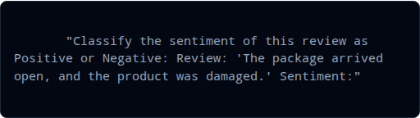
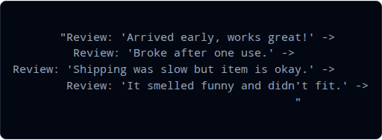
Zero-Shot vs. Few-Shot
1. Zero-Shot Prompting
2. Few-Shot Prompting
Definition: Giving a task with zero examples. Good for simple jobs.
Definition: Showing 1-3 examples of how you want it done first.
Positive
Negative
Neutral
[Model easily outputs Neutral or Negative]

Slide 8


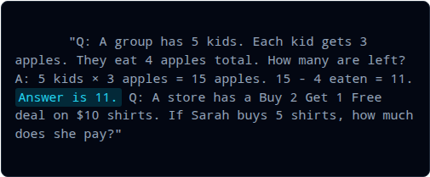
Chain-of-Thought (CoT)
Example Prompt (With Reasoning Example)
Step-by-Step Reasoning
Definition: Forcing the AI to explain its math or logic steps before giving the final answer.
This mimics human behavior: we rarely solve complex logic problems instantly; we work them out on paper first. Showing the AI the reasoning process reduces calculation errors.

Slide 9


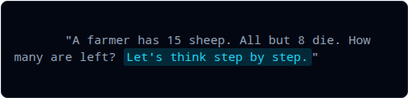
Zero-Shot CoT
How to Use It
The "Magic Phrase"
Add this exact line at the end of your question:
Definition: Simply adding a short trigger sentence to trigger reasoning without providing any custom examples.
By telling the model how to start, it automatically triggers a breakdown of logical steps, yielding much higher accuracy.
Helps avoid simple trick-question mistakes.

Slide 10

Self-Consistency
Majority Voting Strategy
The Voting Path
Definition: Asking the AI the same logical question multiple times (e.g., 5 times) and picking the answer that appears the most.
AI can occasionally make a careless mistake on one path. By exploring different paths, the correct answer usually wins the majority vote.

Slide 11




Tree of Thoughts (ToT)
Definition: Designing a prompt that forces the AI to outline several possible ideas, evaluate each one, reject the bad ones, and build on the best ones.
1. Explore
2. Evaluate
3. Backtrack
Generate 3 different solutions to the problem.
Identify flaws and rate them: [Promising] or [Dead End].
Discard the dead ends and build upon the winner.

Slide 12


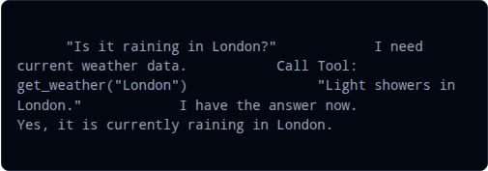
ReAct Prompting
How Agents Make Decisions
The ReAct Loop Example
Definition: Prompting an AI to cycle between Thinking (reasoning about what is happening) and Acting (using a tool to gather facts) before answering.
User:
Thought 1:
Action 1:
Observation 1:
Final Answer:
Thought 2:
This is the standard design pattern for building autonomous AI agents today.

Slide 13



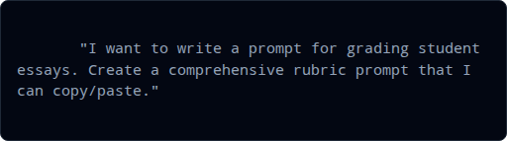
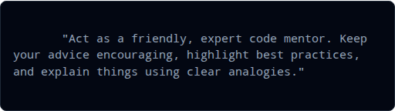
Personas & Meta-Prompting
Personas (Who to be)
Meta-Prompting (Prompt Helper)
Definition: Assigning a clear background identity to steer the AI's language style.
Definition: Asking the AI to write or optimize a prompt for you.

Slide 14


Structured Outputs & Chaining
Essential Production Tools
Structured Outputs: Forcing the AI to reply using clean JSON, lists, or tables rather than messy paragraphs. Perfect for passing data to databases.
Chaining Example Flow
Prompt 1:
Prompt Chaining: Breaking a huge task into a sequence of smaller, easier prompts. Output of Step 1 becomes Input of Step 2.
Prompt 2:

Slide 15
Master Cheat Sheet
Technique | When to Use It | Beginner Cheat Phrase
Zero-Shot | Simple tasks, basic definitions | "Translate this word to Spanish..."
Few-Shot | Specific formatting, styling, classification | "Here are 3 examples of what I want..."
Chain-of-Thought | Basic math, logic, complex instructions | "Let's think step by step."
ReAct | Integrating AI with APIs or web tools | "Write your Thoughts and Action first..."
www.agentic-ai-mastery.com

